Slide 1
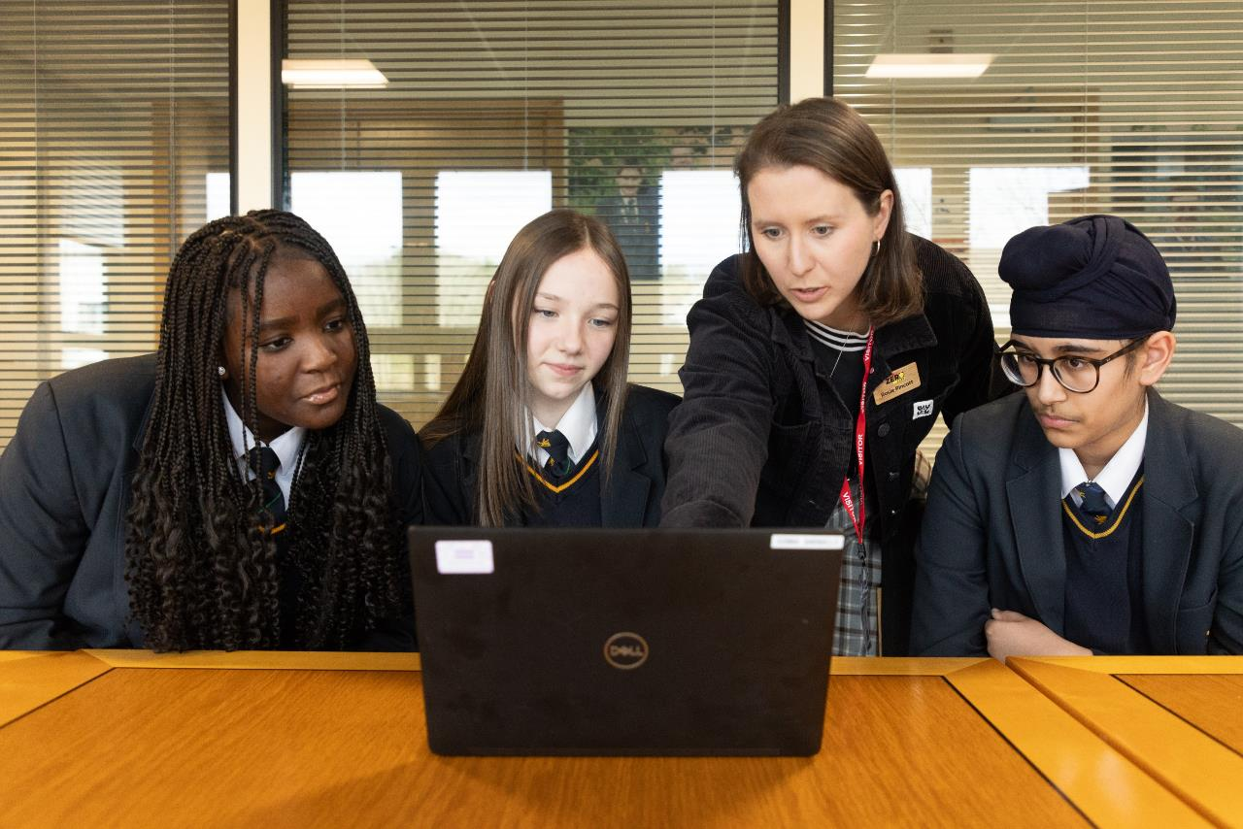

Carleton Rode & Forncett St Peter
End of Year 1 Impact Report
Jan 2026
Notes:
Image to be replaced with one of the school if you have a high enough quality image or a standard LGZ image

Slide 2
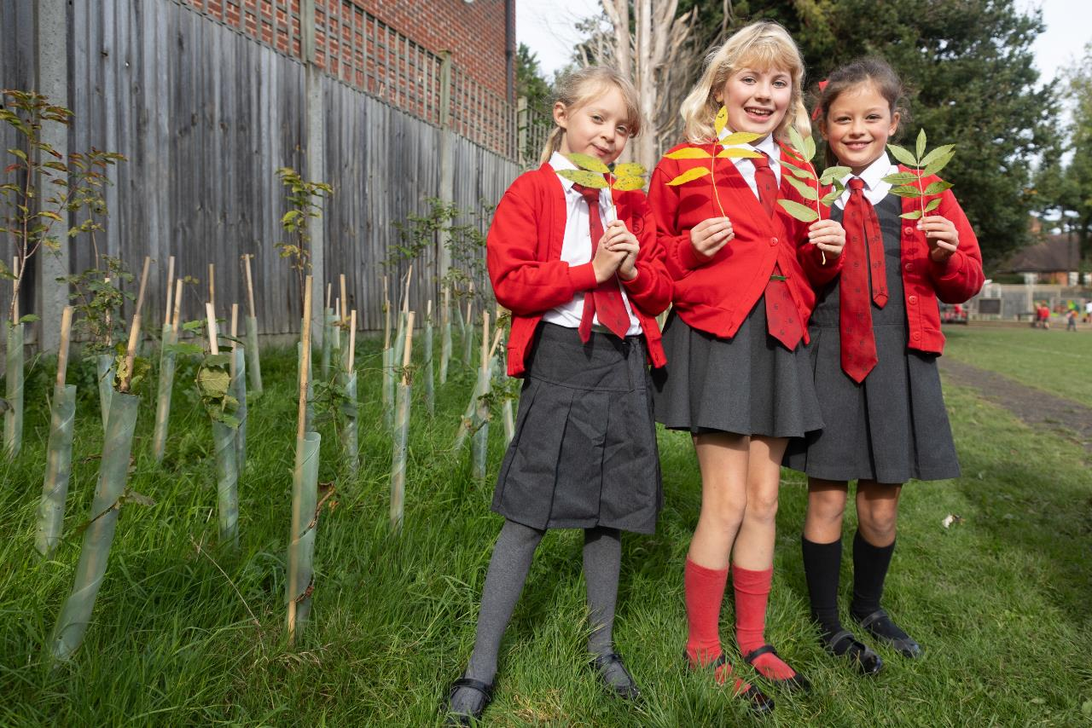

This report covers:
A comparison of your Baseline and End of Year 1 Carbon footprints
Your completed Year 1 actions & those to keep/ embed in Year 2
Some remaining incomplete actions from Year 1 to consider
New suggested actions to raise ambition in Year 2
Our ongoing support
www.letsgozero.org
charity no: 1104153
Notes:
Image to be replaced with one of the school if you have a high enough quality image or a standard LGZ image

Slide 3

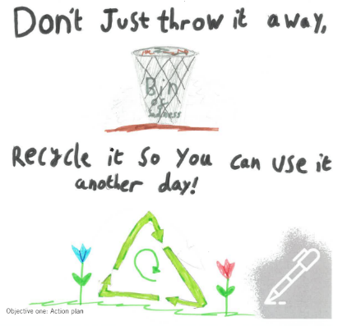



What a great year...
Better understanding of energy data and heating controls.
Sorted out food waste collection at Carleton Rode.
Joined Plastic Free Schools at both sites.
Have support for Eco-club at Carleton Rode.
Notes:
CAA can change the number of examples, plus the icon (click “insert” on toolbar, then icons, then type a suitable search term e.g. food)

Slide 4
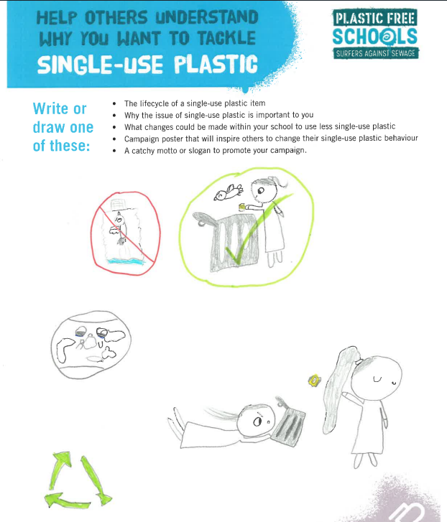
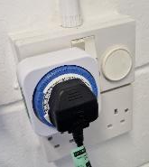
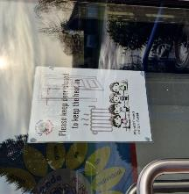
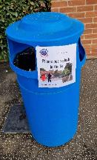
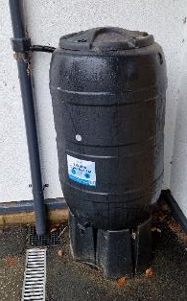
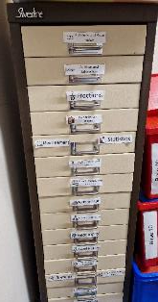
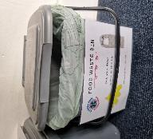

Slide 5

Baseline year 1 (CR): 13th November 2024
Your school's total carbon footprint was estimated to be: 87 tonnes CO₂e per year
End of year 1 (CR): 25th November 2025
Your school's total carbon footprint was estimated to be: 74 tonnes CO₂e per year
 |  | Total Emissions tCO2e
 |  | Baseline | End of Year 1 | % Change to Baseline
 | TOTAL EMISSIONS CO2e: | 87.00 | 73.83 | -15%
Energy and Utilities | Fuel Usage | 4.57 | 5.30 | 16%
 | Electricity Usage | 8.40 | 9.30 | 11%
 | Waste Usage | 0.04 | 0.00 | -100%
 | Water Usage | 0.11 | 0.20 | 82%
Transport | Vehicles | 0.00 | 0.00 | 0%
 | School Trips | 1.31 | 0.90 | -31%
 | Student Commutes | 22.05 | 21.10 | -4%
 | Staff Commutes | 13.88 | 6.10 | -56%
Food | Meals | 8.50 | 8.50 | 0%
Purchases | Spending | 14.95 | 8.10 | -46%
 | Uniforms | 13.19 | 14.30 | 8%

Slide 6
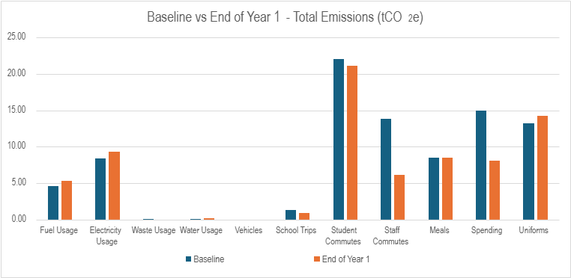


How your two calculations compare
Caveats: Much of the change is due to improved data collection by the school (utilities), or adjustments to the calculation methodology Count Your Carbon uses (specifically student and staff commutes)
Key
CO₂e reduction due to the school’s action
CO₂e change due to other factors
Notes:
Potential wording for any caveats
Student commutes: since your baseline calculation, the tool has been improved, now asking for they typical commute distance rather than the furthest. This may explain some of the changes in emissions shown here. Your raw data for active travel shows a X% increase/ decrease (delete as appropriate)
Staff commutes: since your baseline calculation, the tool has been improved, now asking for they typical staff commute distance rather than using the same data supplied for student commute. This may explain some of the changes in emissions shown here. Your raw data for staff active travel shows a X% increase/ decrease (delete as appropriate). The tool also now asks for information on EV and Hybrid use, data which was not collected in your baseline calculation.
Meals: The typical week’s data for total meals served that you supplied has increased/ decreased since your baseline and this has affected your overall score in this area. The raw data you supplied shows that consumption of veggy meals has increased/ decreased by X%
Spending: your spending increased/ decreased in the area of (e.g. Furniture), this spend was perhaps unavoidable this year but won’t be repeated next year.
Uniforms: the tool has been updated to now ask for % of uniform reused, this wasn’t data collected on your baseline calculation.

Slide 7
Baseline year 1 (F): 13th November 2024
Your school's total carbon footprint was estimated to be: 88 tonnes CO₂e per year
End of year 1 (F): 25th November 2025
Your school's total carbon footprint was estimated to be: 75 tonnes CO₂e per year
 | Total Emissions tCO2e
 | Baseline | End of Year 1 | % Change to Baseline
TOTAL EMISSIONS CO2e: | 85.06 (81.04) | 74.69 | -12%
Fuel Usage | 6.95 | 10.70 | 54%
Electricity Usage | 5.19 | 5.60 | 8%
Waste Usage | 0.02 | 0.00 | -100%
Water Usage | 0.15 | 0.30 | 100%
Vehicles | 0.00 | 0.00 | 0%
School Trips | 0.79 | 0.90 | 14%
Student Commutes | 26.13 | 24.70 | -5%
Staff Commutes | 18.78 | 8.30 | -56%
Meals | 11.13 | 9.30 | -16%
Spending | 11.91 | 14.90 | 25%
Uniforms | 4.02 | 0.00 | -100%

Slide 8
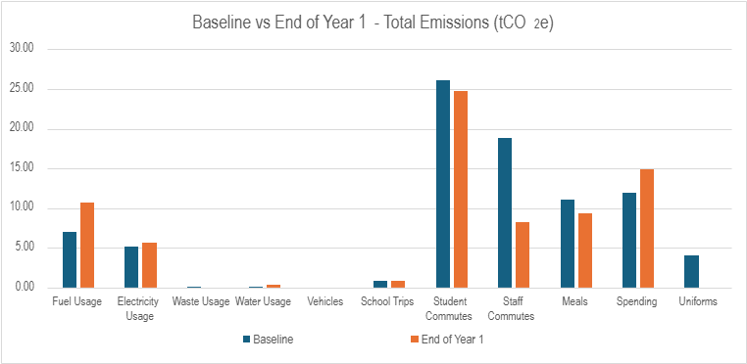
How your two calculations compare
Caveats: Much of the change is due to improved data collection by the school (utilities), or adjustments to the calculation methodology Count Your Carbon uses (specifically student and staff commutes)
Key
CO₂e reduction due to the school’s action
CO₂e change due to other factors
Notes:
Potential wording for any caveats
Student commutes: since your baseline calculation, the tool has been improved, now asking for they typical commute distance rather than the furthest. This may explain some of the changes in emissions shown here. Your raw data for active travel shows a X% increase/ decrease (delete as appropriate)
Staff commutes: since your baseline calculation, the tool has been improved, now asking for they typical staff commute distance rather than using the same data supplied for student commute. This may explain some of the changes in emissions shown here. Your raw data for staff active travel shows a X% increase/ decrease (delete as appropriate). The tool also now asks for information on EV and Hybrid use, data which was not collected in your baseline calculation.
Meals: The typical week’s data for total meals served that you supplied has increased/ decreased since your baseline and this has affected your overall score in this area. The raw data you supplied shows that consumption of veggy meals has increased/ decreased by X%
Spending: your spending increased/ decreased in the area of (e.g. Furniture), this spend was perhaps unavoidable this year but won’t be repeated next year.
Uniforms: the tool has been updated to now ask for % of uniform reused, this wasn’t data collected on your baseline calculation.

Slide 9




Your completed Year 1 actions and actions we suggest you embed in year 2
Signed up to Let’s Go Zero
Accessed the Climate Ambassadors scheme
Set up an eco-club or eco council for pupils to lead on sustainability initiatives at CR
Shared free CPD opportunities with staff
Developed sustainability policy for federation
Worked with curriculum leads (science and geo) to create enrich sustainability days around new curriculum.
Completed a Count Your Carbon calculation (both sites)
Investigated SMART meter and
Installed timer-controlled electric switches e.g. laptop charging banks
Completed Count Your Carbon
Engaged with Master Composters
Optimised underfloor heating controls
Completed travel survey at CR
Formalised a heatwave policy
Taken part in The Nature Park
Climate Education
Decarbonisation
Adaptation
& resilience
Biodiversity

Slide 10
Some remaining incomplete actions from year 1 to consider completing next year
Set up a sustainability working group (alter this wording, as more informal process?) *Continue to engage with staff on sustainability in supporting CAP actions.
Provide CPD opportunities for staff on sustainability
Complete a curriculum audit & incorporate sustainability – *Review current sustainability offer in the curriculum and monitor impact.
Monitor energy use on a regular basis through dedicated platforms
Investigate the potential for a ground/air source heat pump plus solar battery. - CR
Optimise your BMS/BEMS settings and ensure your heating and hot water systems have efficient timings and temperatures set
Follow sustainable practices when choosing external companies and how you use them
Conduct a staff and student travel survey at Forncett.
Develop an active travel plan
Take part in additional recycling schemes
Run waste/plastic reduction initiatives or campaigns with pupils and staff
Have pupils carry out wildlife survey
Climate Education
Decarbonisation
Biodiversity

Slide 11
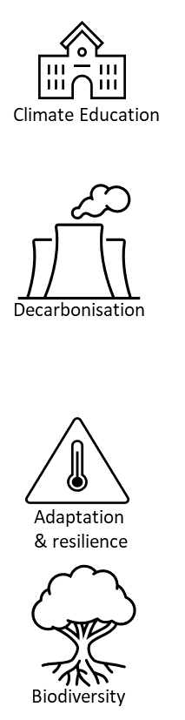
New suggested actions for year 2
*Fed - Establish Federation sustainability webpage, and consider sharing key policies, CAP, carbon footprint, latest achievements and how the wider school community can support the schools aims.
*Fed – Appoint a green governor
*CR – investigate further insulation of buildings.
*Fed - Ensure fridges are emptied and turned off over holidays (where possible)
*Fed - Engage with suppliers on their sustainability policies and practises.
Year 3 - Fed - Develop sustainable procurement policy. Select a few items to explore and swap first i.e. paper or white board pens (Nexus brand pens)
*Monitoring overheating in rooms and consider measures to prevent overheating.
*Fed - Ask wider school community for support with planting and managing garden areas, and providing resources for minibeast hotels, bird and bat boxes.

Slide 12
Next steps
Next week
6-month checkpoint (set date now)
Full year checkpoint
Year 3
We will send over your Year 2 Climate Action Plan and guidance on getting started.
We encourage you to share this with governors/ students/ wider community
Review actions and create your year 3 action plan.
We will ensure you are fully equipped to lead from here.
Check-in on progress and review actions
We encourage you to update us on progress and your plans to complete your plan
Re-run Count Your Carbon calculation
We will ensure you can take the lead on this
Contact your Climate Action Advisor anytime with questions or updates of your progress.
Nigel.stannett@letsgozero.org
www.letsgozero.org
charity no: 1104153

